Slide 1


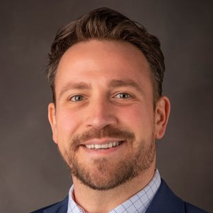
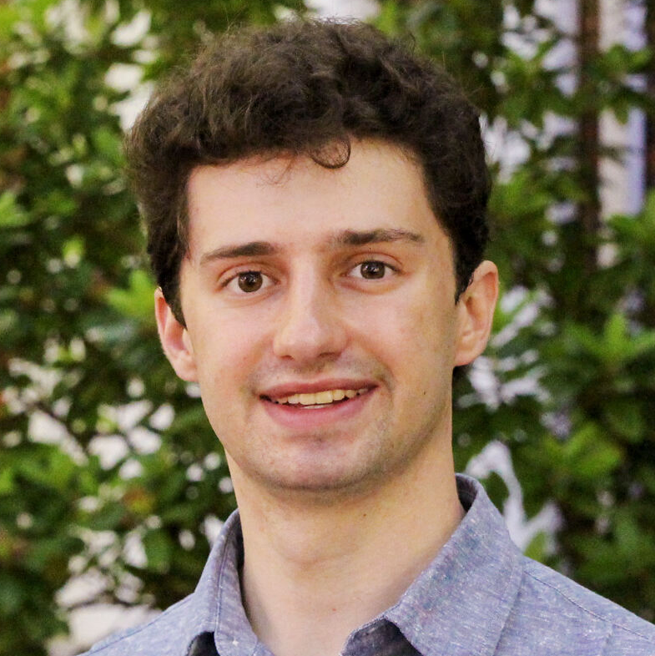

Machine Learning Competition
Mustafa Akben, PhD
Assistant Professor of Management
Aaron Satko
Computer Science & AI Club Co-Chair

Slide 2

Four tasks, Four Challenges
Empathy Prediction — Binary Classification
Item Clarity — Correlational
Interview Completion — Cosine Similarity
Policy Fairness — Binary Classification

Slide 3

Task 1: Empathy Prediction
Zero-Shot COT
Syntactic chain-of-though with N-shot
Context Learning + Text Completion + Self-Consistency
Label Learning Model
Elo Rating for Empathy Ratings
Gemini 1.5 | GPT 3.5 - 4 | Claude3x

Slide 4
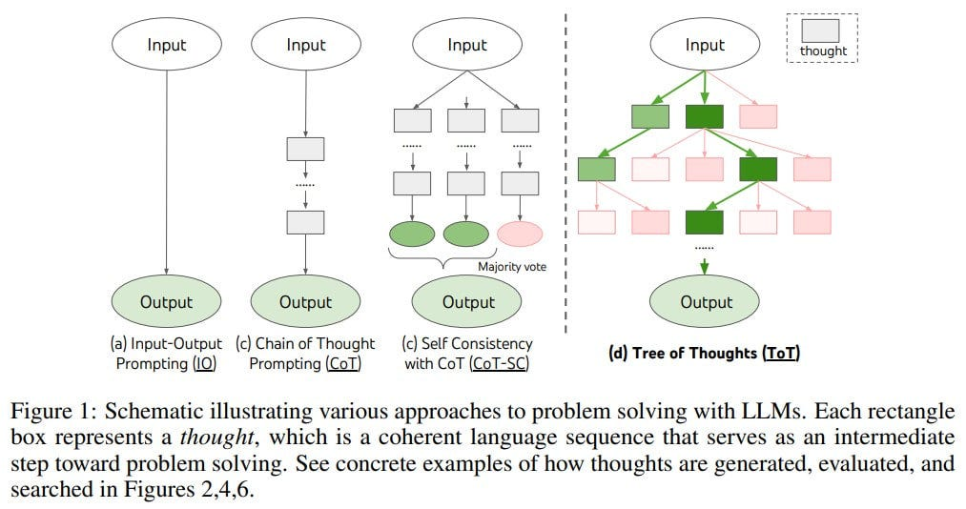
Context Learning + Text Completion + Self-Consistency
Learn from the context inputs
Complete text without any prompt with a foundational model
Bison from Palm | Davinci-002 from GPTs | Gpt3.5-instruct from GPTs
Repeat them N times (N is an odd number to get mode)
Get the mode of the predictions
Accuracy at train : .60 | Dev = .57

Slide 5
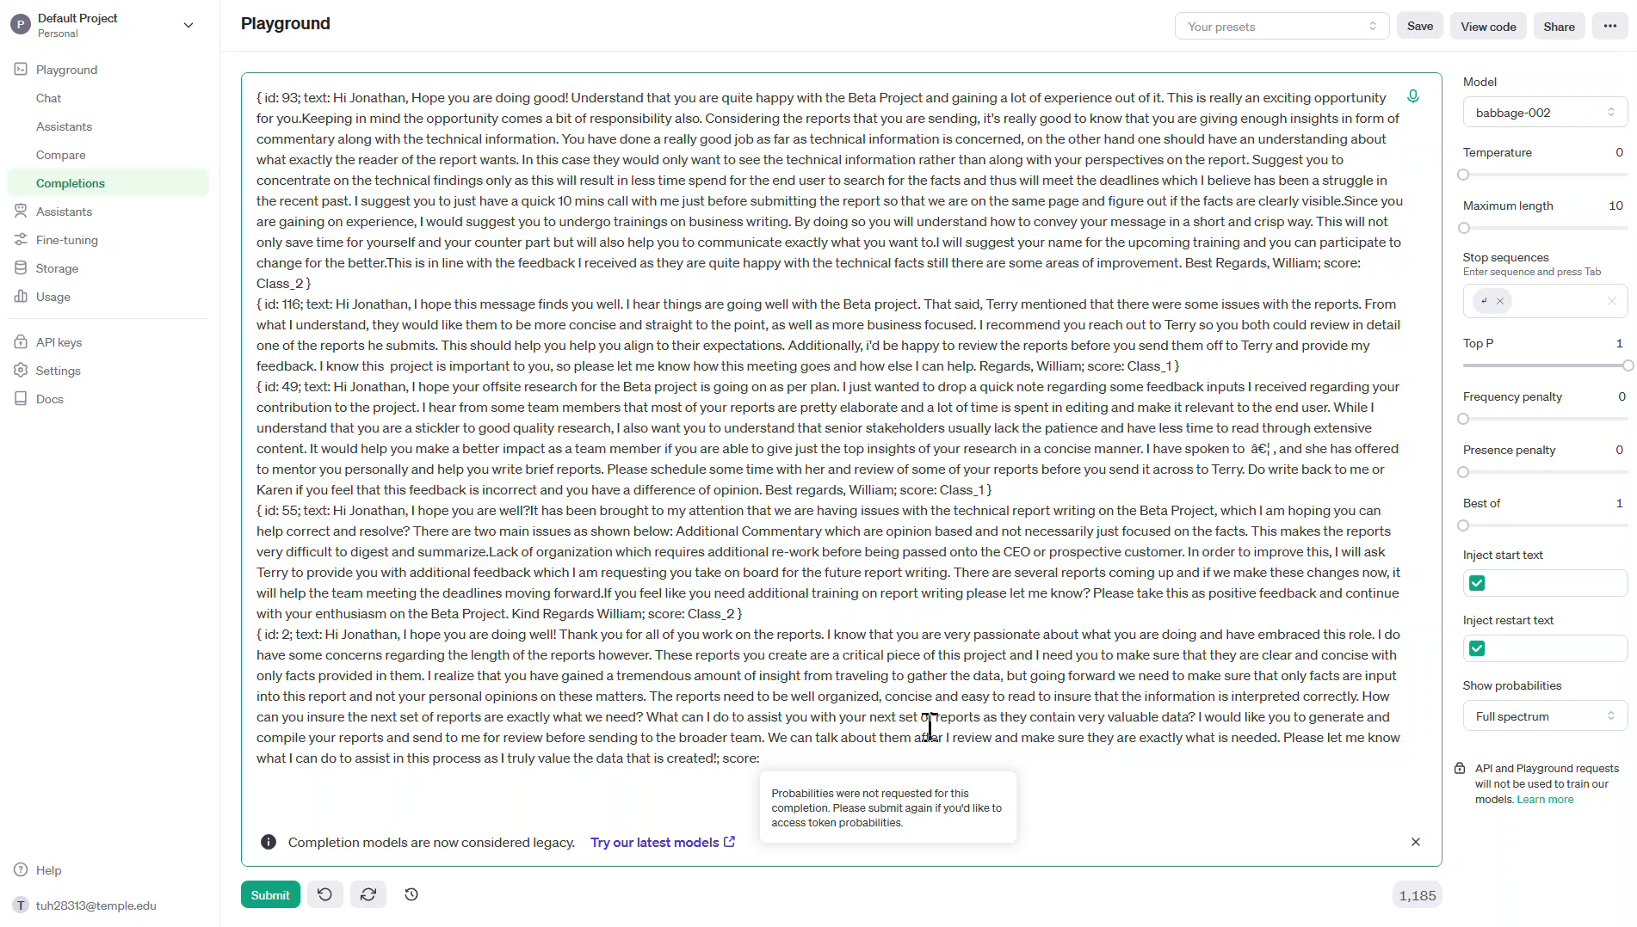

Slide 6

But why?

Slide 7
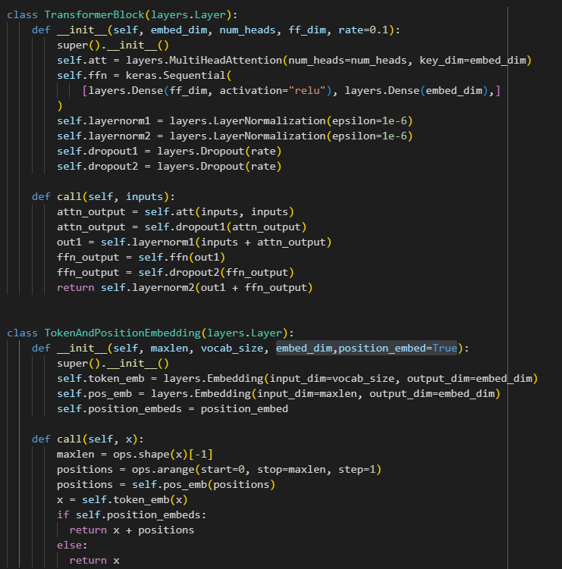

Slide 8
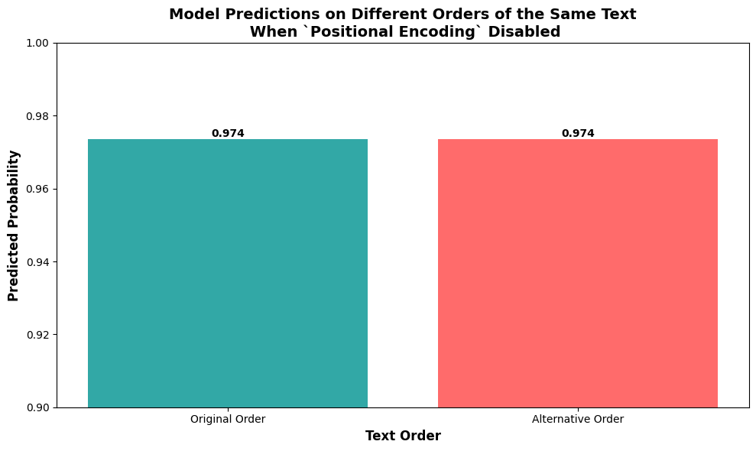
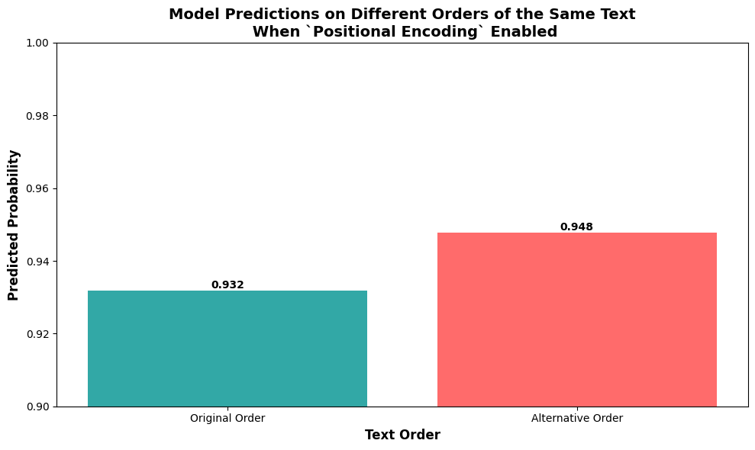

Slide 9
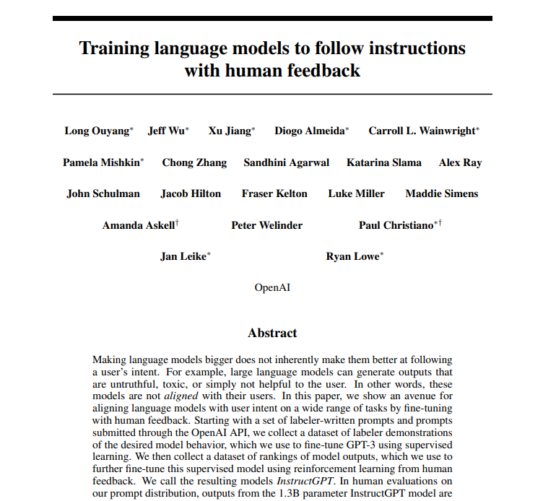
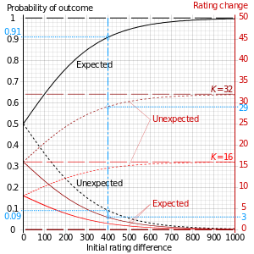
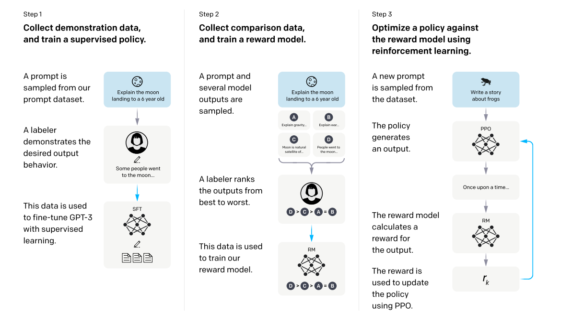
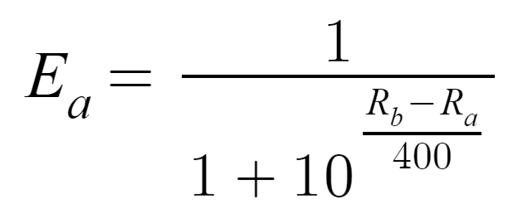
Elo Ratings for Classification
Elo ratings is initially used in chess competitions
LLM & RLHF
Unexpected results change the ratings

Slide 10
Elo Rating | Class X
“Hi Jonathan, I hope this message finds you well. I hear things are going well with the Beta project. That said, Terry mentioned that there were some issues with the reports. From what I understand, they would like them to be more concise and straight to the point, as well as more business focused. I recommend you reach out to Terry so you both could review in detail one of the reports he submits. This should help you help you align to their expectations. Additionally, I'd be happy to review the reports before you send them off to Terry and provide my feedback. I know this project is important to you, so please let me know how this meeting goes and how else I can help. Regards, William”

Slide 11
Elo Rating | Class X
“Hi Jonathan, First off i'd like to say i'm very pleased to see your enthusiasm towards your work with ABC-5, I appreciate your commitment to doing your best work for the company. I would like to offer some insight into your work that should assist you in achieving your goals. We all need to be continually improving to move forward and I believe I can provide you with some assistance in this area.In regards to your report writing, i'd like to to understand that although your reports cover a lot of good information, we need to keep in mind the target audience and the key objectives of the information. The people that read these need to be able to digest the critical points and understand the facts, so try to find the best way to make the information concise and strictly factual. In addition to this, reports are much more useful when the structure or flow of the report is orderly, it asissts the reader in understanding the information within and allows them to make informed decisions based on your data. It may be a good idea to ask your manager for training opportunities for report writing to develop your skills even further, and be sure to reguarly check in with your manager to make sure your work is aligned with the objectives of the team.I hope these points help you in your job. Please keep up the great work! Thank you!”

Slide 12
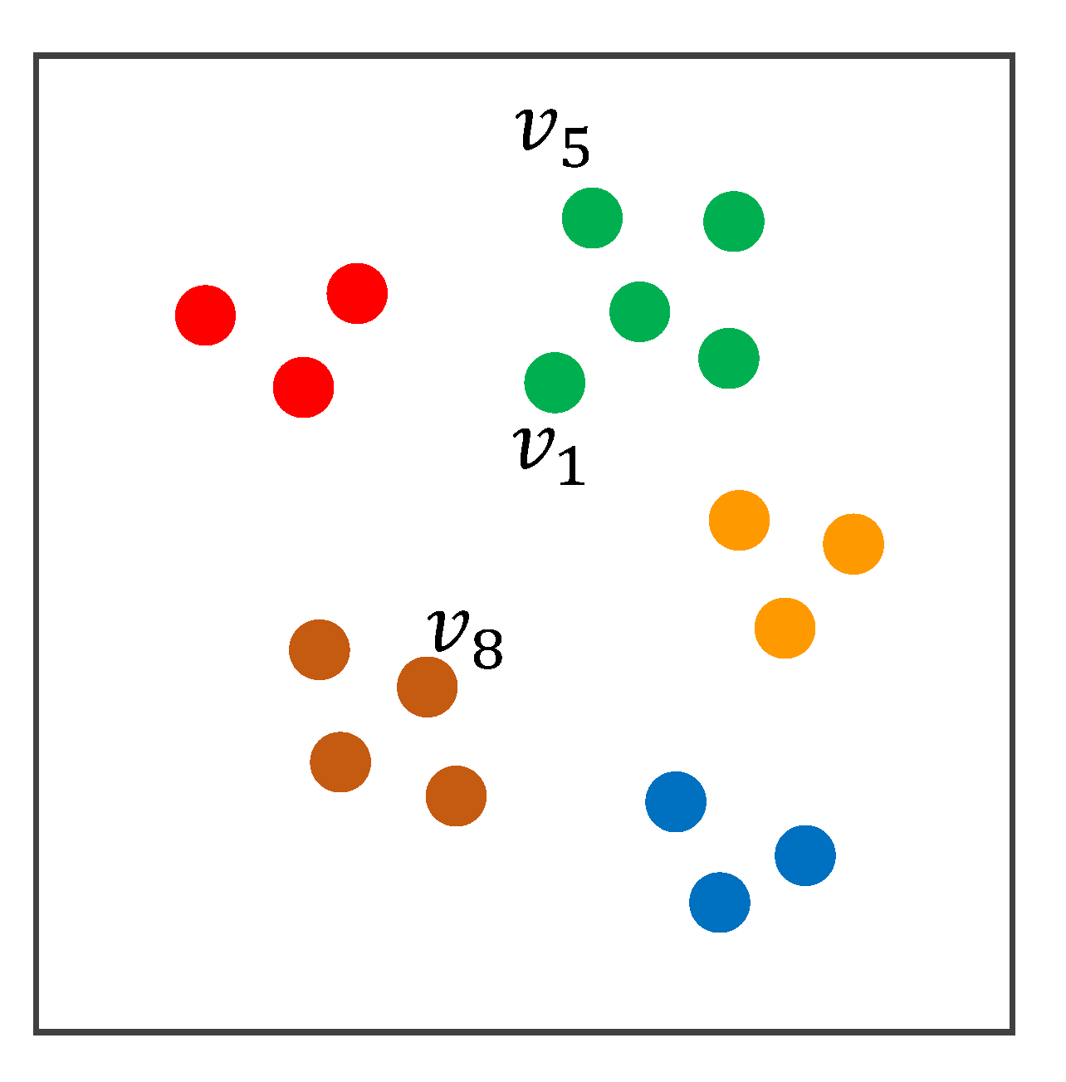
Elo Ratings Classification

Slide 13
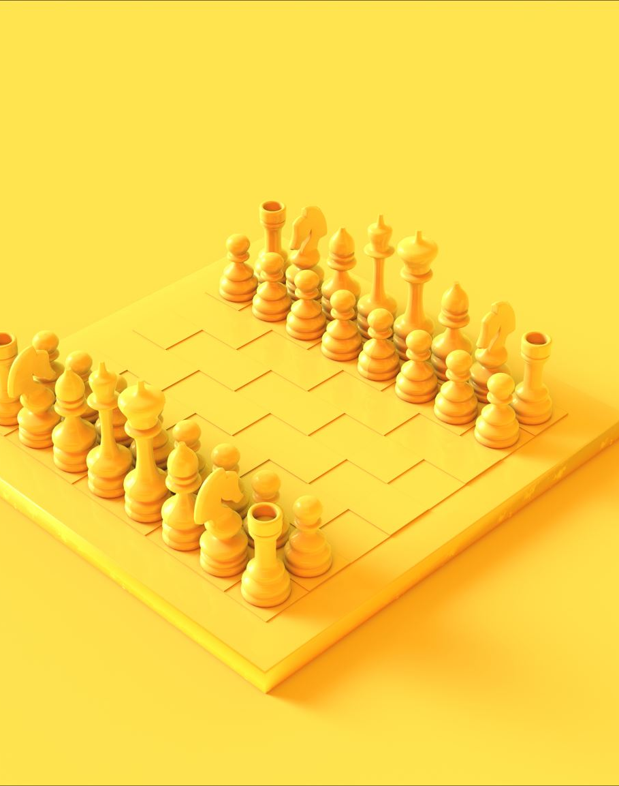
Elo Rating
1- Sample two semantically similar content
2- Ask GPT4 model to choose one
3- For the chosen one, Win rate +1
4 – Calculate the Elo Ratings
5 – Repeat this comparative game N times
6- Transform the Elo Ratings to probs
Prompt
Which feedback would you prefer? You will pick the feedback that makes you feel motivated to work harder and understood, rather than being judge. Return either `Text 1` OR `Text 2`
# Text 1
#Text 2
Accuracy in train based on the games: .70 | Dev = .63-.65

Slide 14
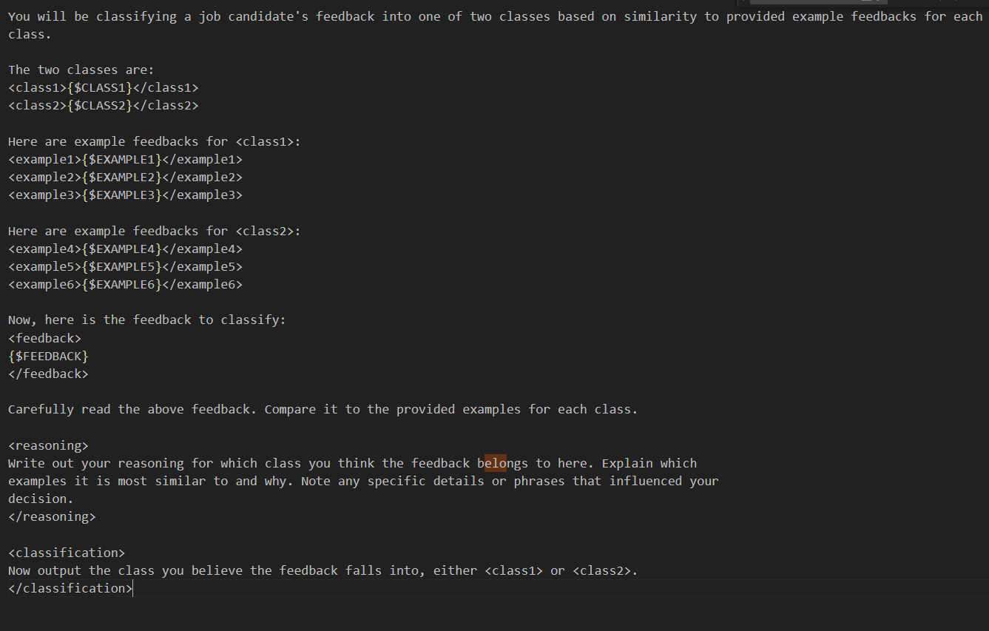
Label Learning Model

Slide 15
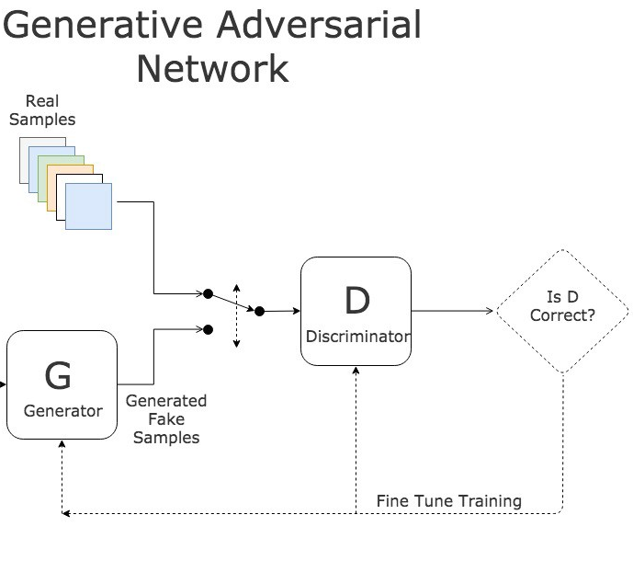



Experimenting with GAN – LLM Agent Models

Slide 16

Final Empathy Prediction
Ensembled all prediction from
Text completion N-shot
Elo Rating
Label Learning
Majority Votes
Train Accuracy = .66-.70
Dev = .60 - .63

Slide 17

Task 2: Item Clarity
Label Learning with Meta-Prompt (Latent Space Learning)
Generate N – Expert for each sub dimension (Binary) for each model
GPT4
GPT3.5
Claude3
Aggregate the average ratings as an expert ratings from the models
Use a final ensembled rating for the full text with a stronger model

Slide 18

Meta-Prompt
You will be analyzing a set of survey item texts and their corresponding clarity scores to identify patterns that distinguish items that received high clarity scores from those that received low scores.
Here are the survey item texts:
{text}
Please generate binary rules for the classes.

Slide 19
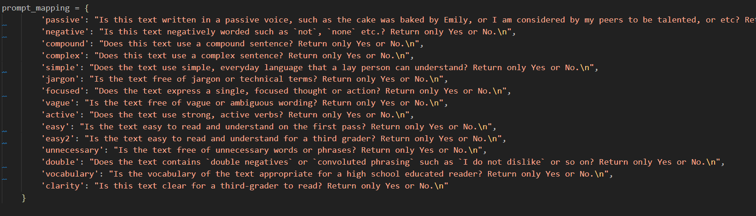
Binary Questions

Slide 20
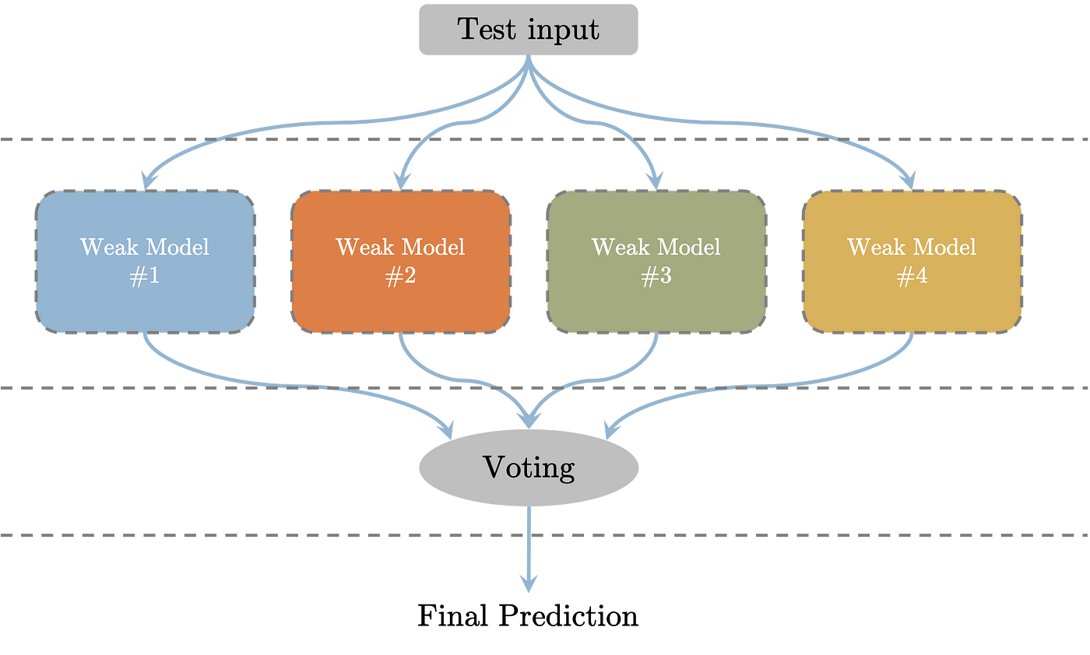
Train Corr: .70-.80
Dev Corr: .60-.70

Slide 21

Task 3: Interview Completion
Gpt4 Model
Instructed to complete task based on the style, tone, and important characteristics
Generate N in-context examples
In-context so that model generate more diverse examples
Selected the completion that has the highest cosine similarity with the input
Cosine Similarity: .50 - .53

Slide 22
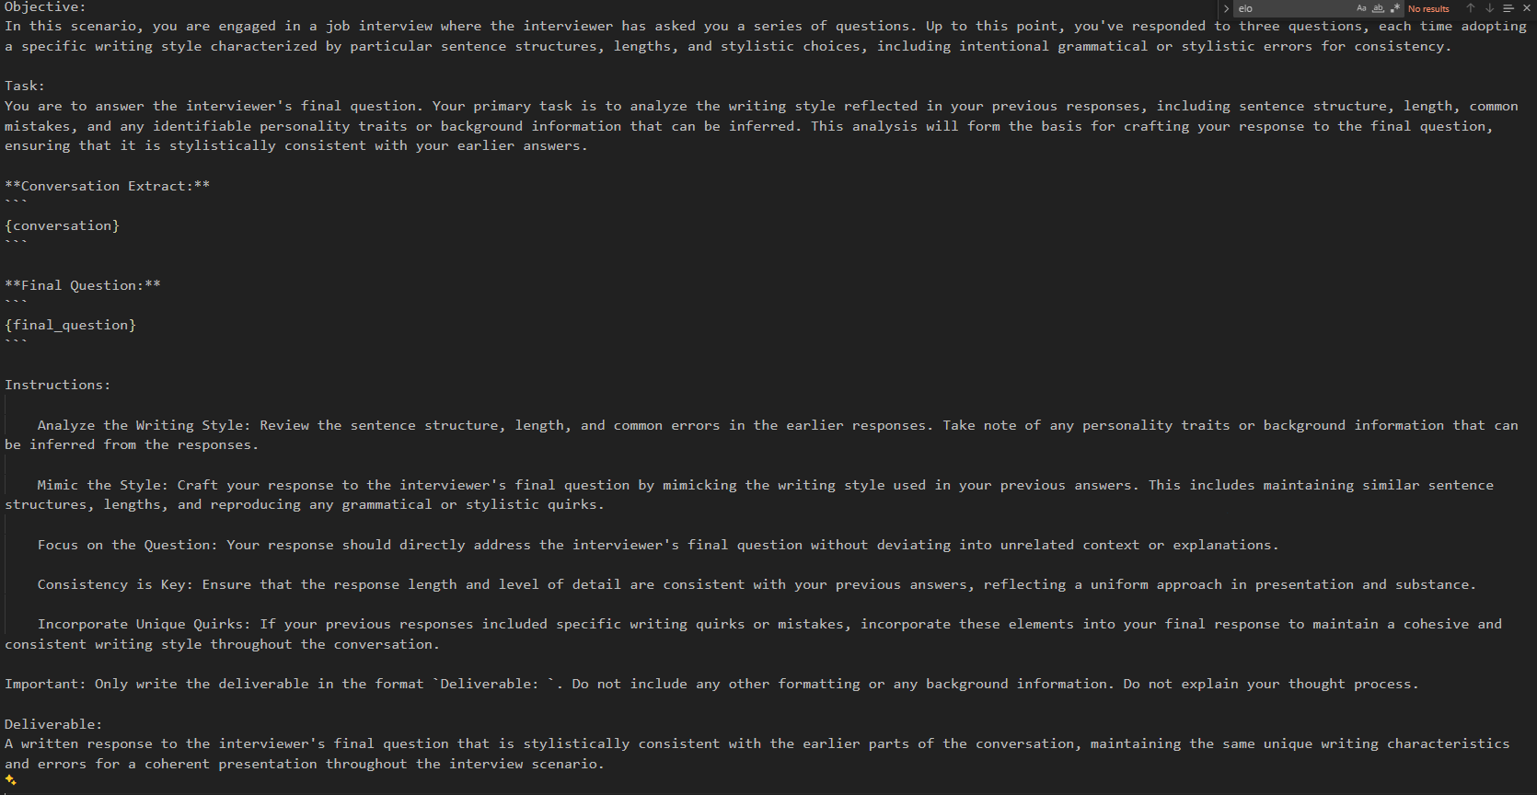

Slide 23

Task 4: Policy Fairness
N-shot self-consistency learning
Provided all examples in-context
Predicted test target
Repeated for N (N is an odd number)
GPT4 Used
Accuracy : .83 - .86

Slide 24
Actual Prompt
Question: Which policy statement is the much fairer option?
# Option 1: We recommend employees start a support group to share and address workplace concerns.
# Option 2: Grievance Resolution Committee: A committee addresses formal grievances and ensures a fair resolution process.
# Answer: second
Question: Which policy statement is the much fairer option?
# Option 1: A mentorship program pairs employees with experienced colleagues, providing guidance and preventing conflicts.
# Option 2: We've implemented a complaint card system to track and address employee concerns effectively.
# Answer: first
….
Question: Which policy statement is the much fairer option?
# Option 1: Conflict Resolution Apps: We offer technology solutions for reporting and tracking conflicts.
# Option 2: Employees can request a mediator to assist in resolving issues with their supervisor, ensuring fair dispute resolution.
# Answer: [‘target]’

Slide 25
Lesson Learned
Do not use labels for murky concepts
Elo ratings was an interesting idea to explore
Gpt4 model sometimes so verbose (interview completion)
For some task, simple methods is the best
Experiment and fail quickly

Slide 26

Thank you for your attention!
Mustafa Akben, PhD
Assistant Professor of Management
Aaron Satko
Computer Science & AI Club Co-Chair

